Slide 1

COFFEE SHOP SALE ANALYSIS
Using Excel

Slide 2
TOTAL SALE BASED ON HOURS
CATEGORIES PERCENTAGE DISTRIBUTION
LOOK INTO THE PIVOT TABLE
Table of contents
GRAPHICAL PRESENTATION OF TREND
TOP 5 PRODUCTS SALE
KEY PERFORMANCE INDICATOR & ORDERS BY SIZE
WORLD MAP SLIDE
COFFEE’S AGRICULTURE
THANK YOU

Slide 3
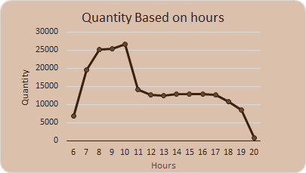

TOTAL SALE BASED ON HOURS
In the graphical presentation, the quantity of orders is based on the hours of the day. It starts at 6 am and peaks at 10 am. The last coffee order is at 9 pm.

Slide 4

CATEGORIES PERCENTAGE DISTRIBUTION
According to the graphical presentation, the highest percentage of orders by volume is for tea at 38%, followed by coffee at 27%, Bakery orders at 12%, and lastly, Loose Tea orders at 11%.

Slide 5
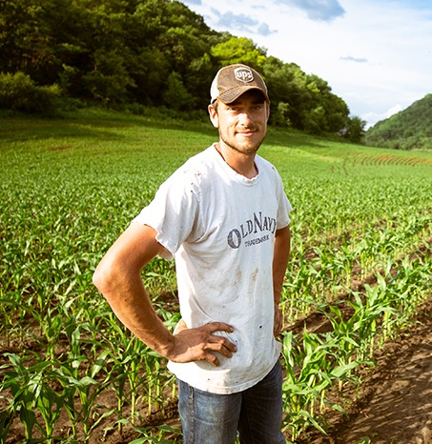

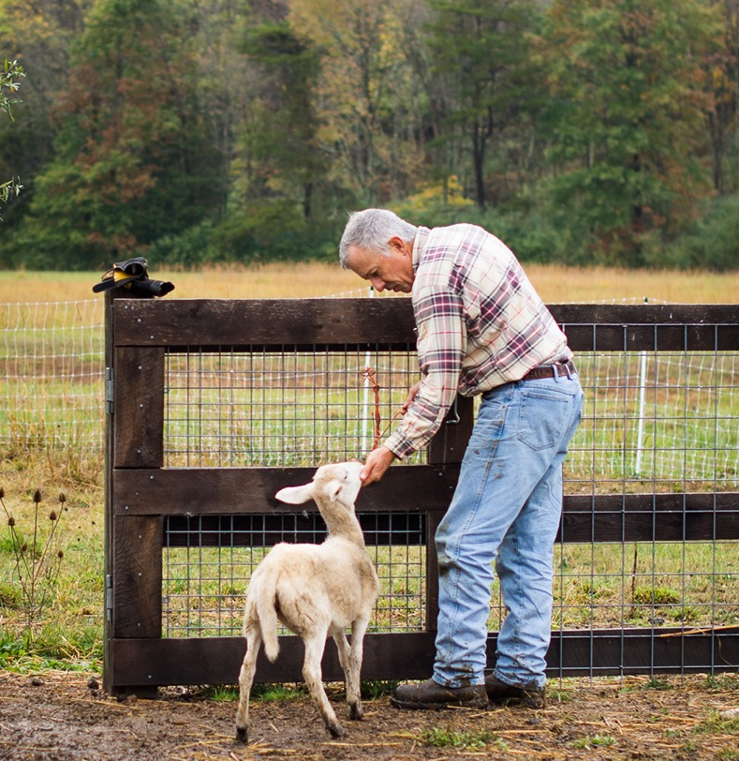
LOOK INTO THE PIVOT TABLE
Total transactions made in days
Total transactions Bill made in Months
Total transactions made Based On Size

Slide 6
GRAPHICAL PRESENTATION OF TREND
Graphical representation of the total bill amount for each month in a given time period.
Total order Count on weekdays basis & Order trends by weekdays

Slide 7

TOP 5 PRODUCTS SALE
In the graphical presentation, we can see the top five best-selling products: Barista, Later Brewed Chai, Later Hot Chocolate, Later Gourmet Brewed Coffee, and Later Brewed Black Tea.

Slide 8
KEY PERFORMANCE INDICATOR & ORDERS BY SIZE
Tokyo
Make a big impact with our professional slides and charts.
Barcelona
presentation, we can observe that the distribution is based on the size of orders placed by individuals. The total percentage of large orders is 30%, the total percentage of regular orders is 31%, and the total percentage of small orders is 9%. However, the remaining data is undefined in the data model. are not defined in the data model
Bucharest

Slide 9
WORLD MAP SLIDE
ASTORIA
In Astoria total transaction count 50599
HELL'S KITCHEN
In Hell's Kitchen total transaction count 50735
LOWER MANHATTAN
In Lower Manhattan total transaction count 50735

Slide 10
COFFEE’S AGRICULTURE
Coffee's agricultural impact spans regions, shaping economies and environments. Cultivation provides livelihoods for millions, yet often strains ecosystems. Consumers relish its flavour and energy boost, but consumption patterns impact health and sustainability. Balancing these factors is crucial for a harmonious coffee culture.
In conclusion, coffee's agricultural impact on the world is multifaceted, with both positive and negative implications for growers and consumers. Balancing the economic benefits of coffee production with environmental conservation and social responsibility is essential for ensuring a sustainable future for the coffee industry.

Slide 11




https://www.linkedin.com/in/ranjan-k-b519a31bb/
https://github.com/ranjan20172/Coffee-Shop-Analysis
https://www.instagram.com/i_amranjank/
THANK YOU

